Slide 1

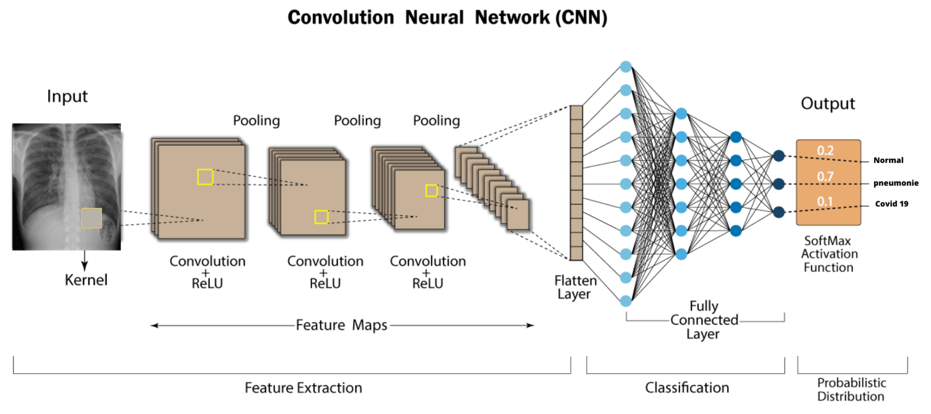
What will we be dealing with in Computer Vision?
Computer Vision (CV) algos allow us to tackle tasks such as Object Detection, Recognition, Image Classification etc.
Is it a cat or is it a dog?
Detecting diseases using CNNs

Slide 2

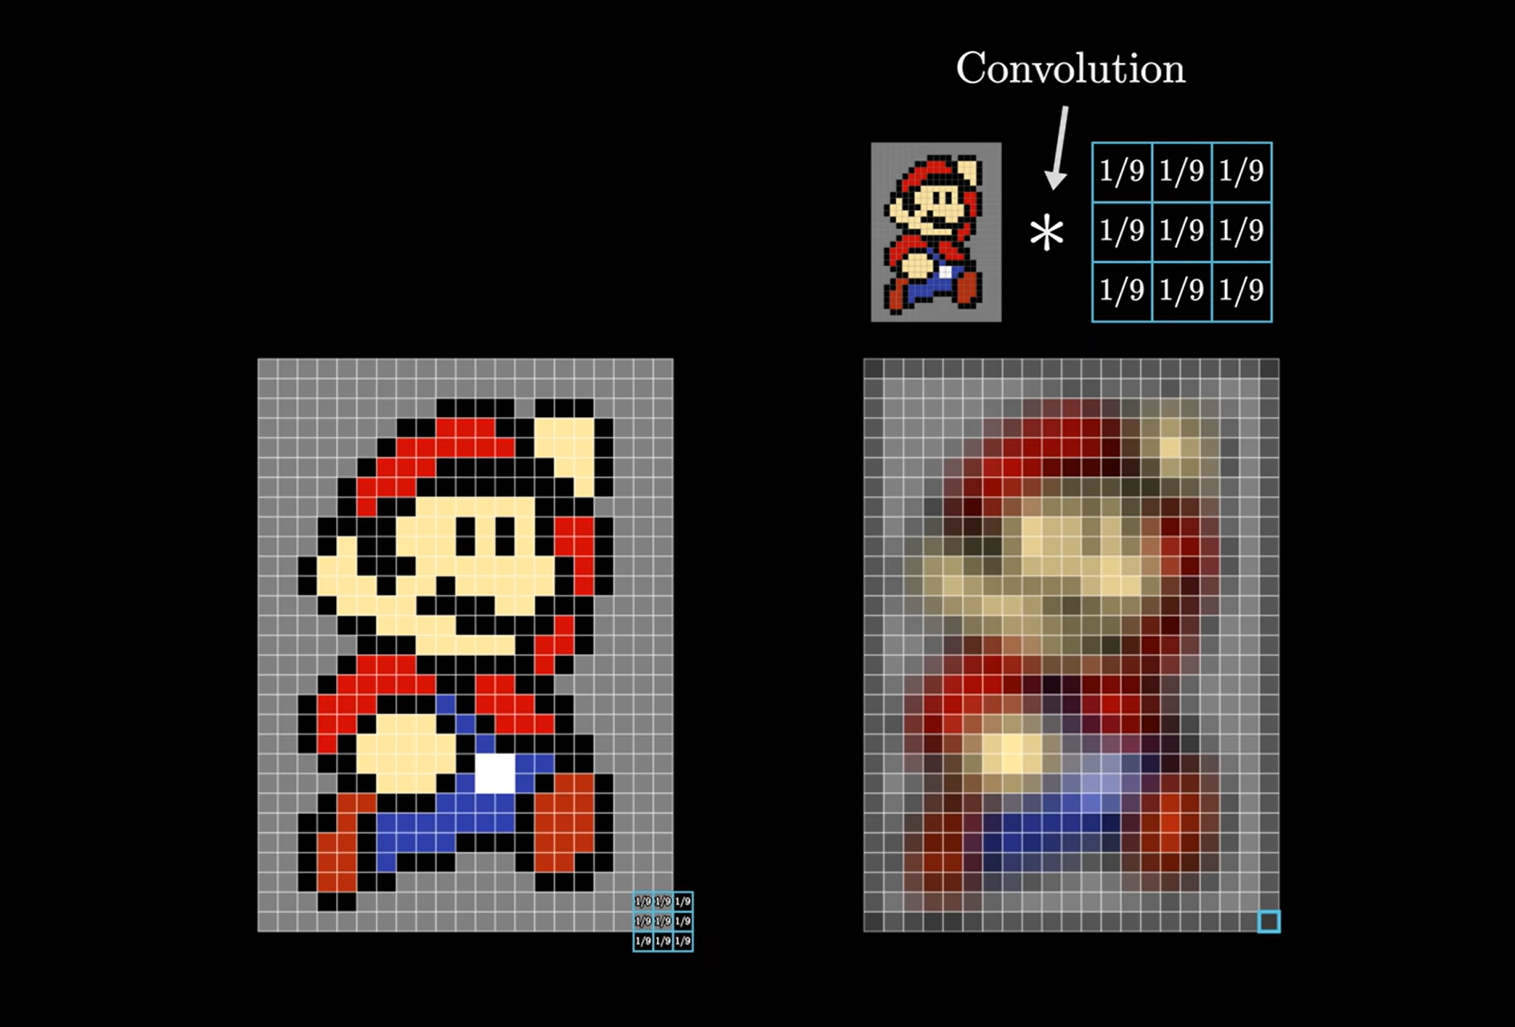
What do you mean by Convolutions?
Contrary to the name, It’s not “convoluted” guys.
It’s just a little operation we perform on an image! Nothing else!
Think of it as placing a small grid of numbers, over a bigger grid of numbers and doing some mathematical operations between the overlapping numbers.
This is how it happens
This is what it does! (we got Mario in a CNN workshop before GTA VI)

Slide 3
Let’s Dive in
The concept of Convolutions is the basis of CNNs!
Think of an image as a grid of numbers where each number represents the brightness of a pixel (for simplicity: grayscale image)
Now we have a smaller grid of numbers (a smaller image) which we call as “filter” (a.k.a “kernel”)
Now you place the smaller grid of numbers and fit it into the top left corner of the image grid and multiply each pixel’s number in the overlapped image with the corresponding number in the filter
Let’s look at an example.

Slide 4
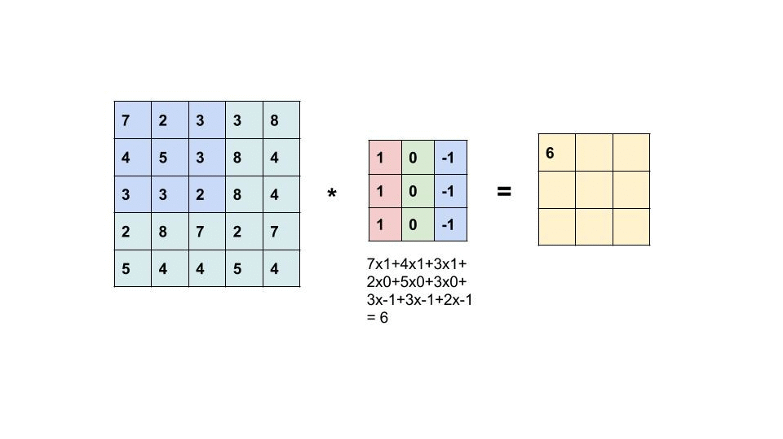
Convolution of a 5x5 image with a 3x3 filter

Slide 5
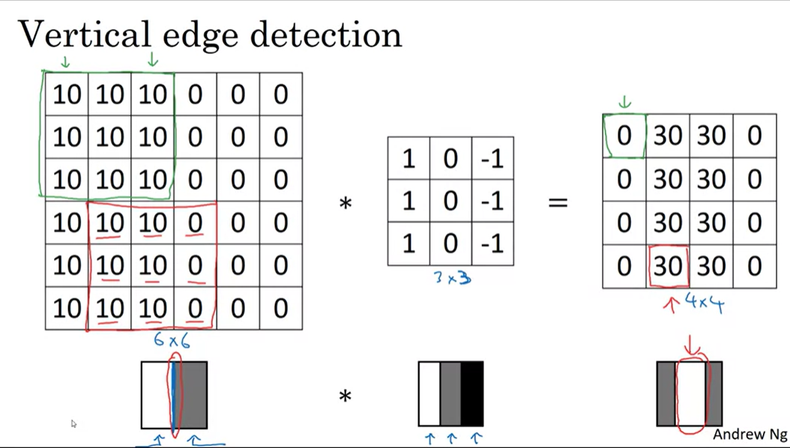
Okay cool… but why?
Now we can look at different features of an image and have a way to represent them, let’s detect vertical edges in a grayscale image
We can see a sharp line going down the middle of the image, when we perform convolution using a filter which looks something like that, we will get an output image with again bright pixels going down the middle
It signifies we have successfully detected a vertical edge inside our original image!
We can also detect horizontal edges! Just rotate the filter by 90 degrees!

Slide 6
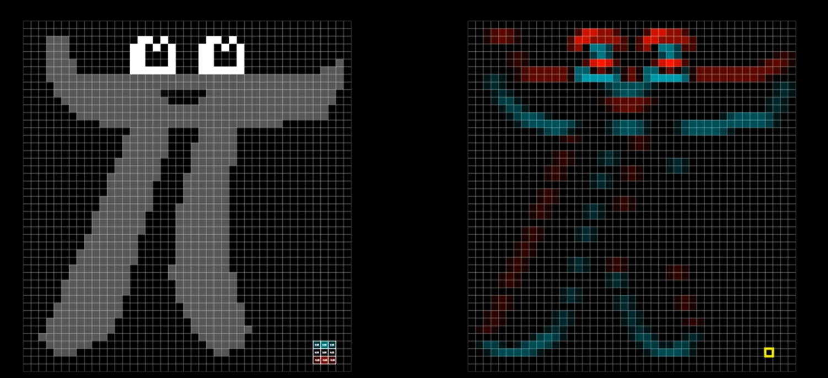
Here’s how (horizontal) edge detection looks

Slide 7
A few things to note!
We saw some negative numbers in our grids which represent the brightness of a pixel → No problem, Negative numbers signify change in intensity of pixels, we can choose to just take the absolute value of every pixel as well and edge detection would work just fine!
Filters aren’t just useful for edge detection, they can detect a multitude of features
In a lot of cases, The smart people have already figured out what filters to use so don’t worry about them. For example, in case of edge detection we have Sobel filter, Scharr filter etc.

Slide 8
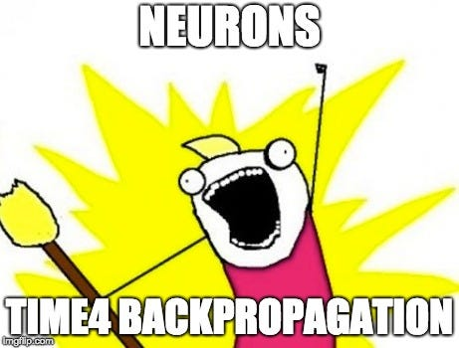
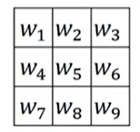
But what if I want to detect something more complicated in an image?
The smart people can’t save us now :(
Now it’s time for the Neural Network to be trained and pick it’s own filter
Think of every pixel value in the filter as a parameter which must be learned by the NN
(maybe the real parameters are friends, our NN makes along the way)

Slide 9

Don’t worry about Backprop :)

Slide 10
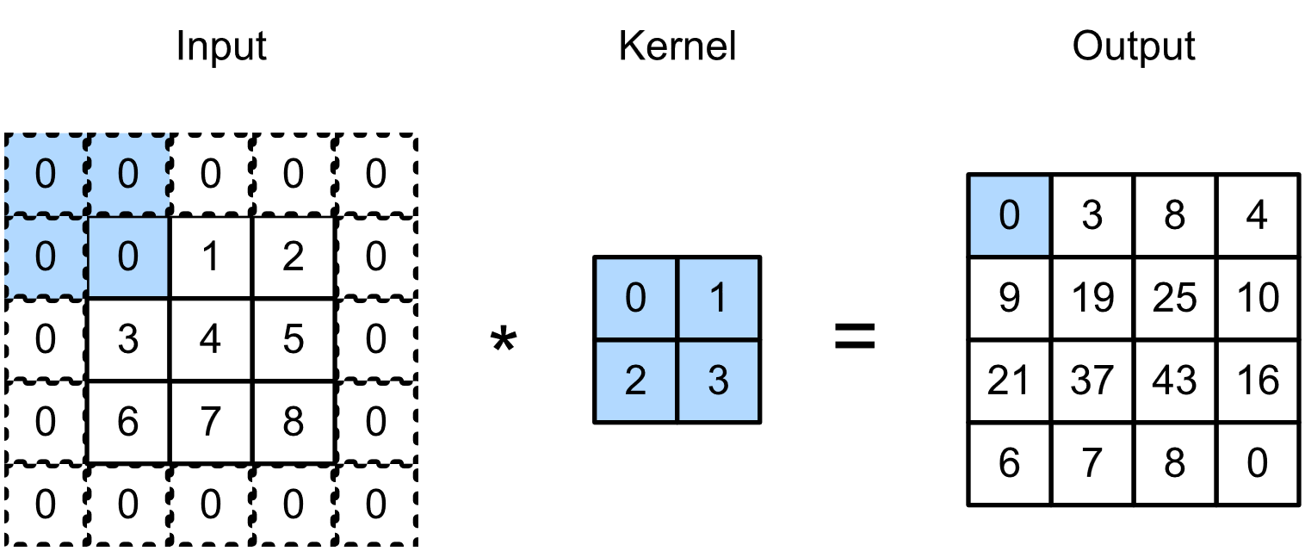
Padding
Did you notice, when we performed convolution the size of output image changed?
Let the image be of NxN size and let the filter be of FxF size then our output image size will be SxS such that:-
S = N + F – 1
What if we want to keep the size of our output image same for sometime?
Answer: Padding
5x5 2x2 4x4

Slide 11
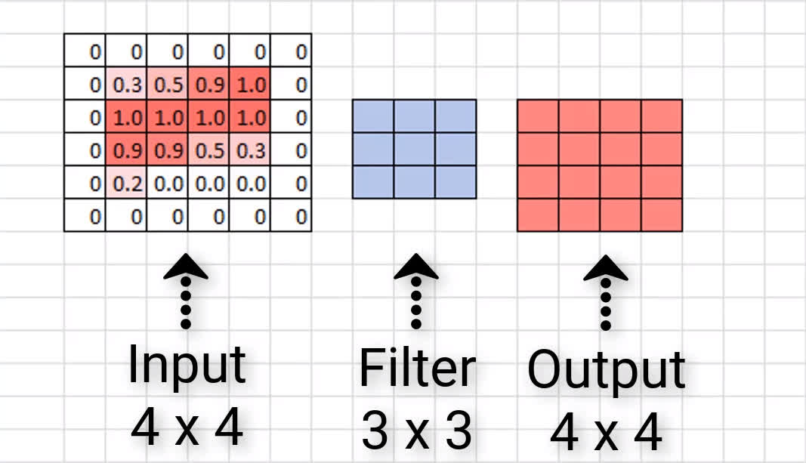
Keeping the same dimensions
As you can see, this time in the input image, we have padded (covered) it with a layer of zeroes, the size of the padding border is p=1
Now with padding we get the relation:-
S = N + 2P – F + 1
PS: Don’t worry about remembering the formulae

Slide 12
Valid and Same Convolutions
These are just two types of convolutions
1. Valid Conv: No padding, S = N + F - 1
2. Same Conv: Pad the image such that the dimensions don’t change (Example if input image is a 8x8 image then the we want the output image to be 8x8 as well)
For this we need to calculate the correct amount of padding:
S = N + 2P – F + 1 = N
S = (F - 1)/2
F is usually odd, so don’t worry about non-int values

Slide 13
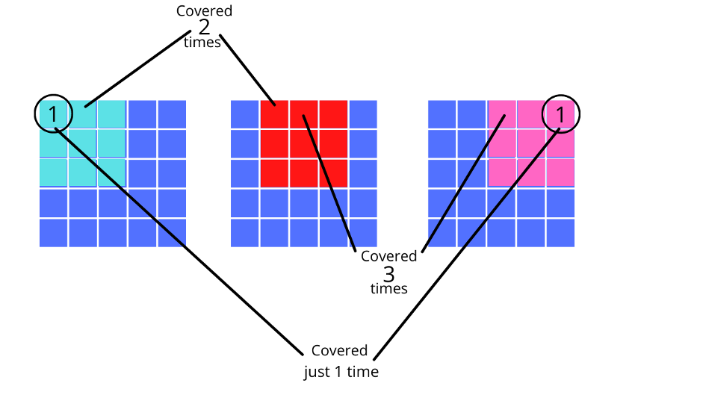
Why should I care about Padding?
Let’s go back to when I told you to place a smaller grid of numbers (the filter) over the bigger grid of numbers (the image) starting from the top-left corner and shift it
Did you notice, the corner pixels were only overlapped once by the filter?
That means in the output, corner pixels contributed only once while other pixels might have contributed more!
OH NO! The corner pixels are being neglected! What if they contain valuable information!? Solution: you guessed it…. Padding.

Slide 14
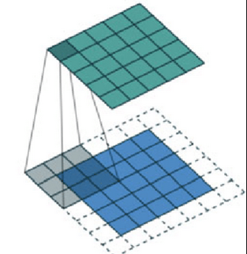
Padding an image keeps corner neglect away!
Now the corners will be covered more than one times, ensuring that whatever information is on the edge or the corner of the image does get carried over to the output image after convolution

Slide 15
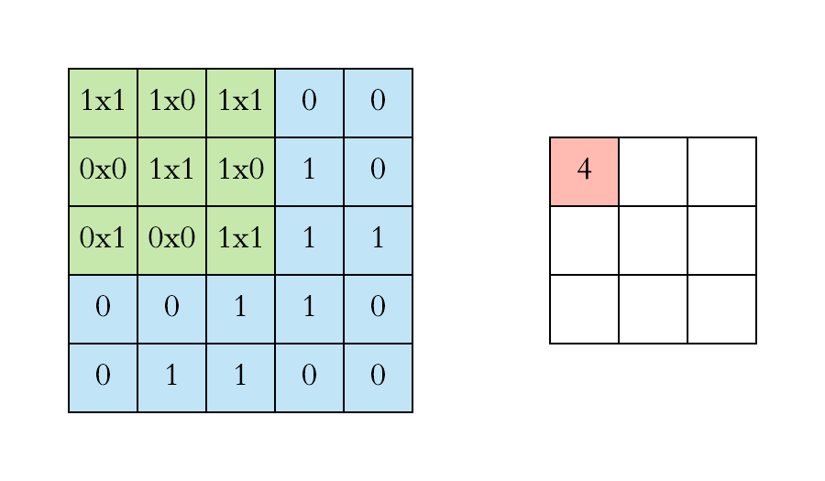
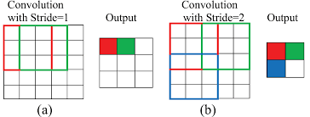
Strides
Once again, revisit the placing the filter over the image part. When performing convolution we just shifted our filter by one step/pixel.
We can customize our convolution operation to instead shift by ‘n’ steps instead of one single step. This is called a stride (s)
Stride (S = 1) of one step

Slide 16
Why should I care about Strides?
In some cases, maybe we don’t need to extract every little feature (detail) from the image.
In those cases, increasing the steps involved in stride is helpful. It reduces the dimensions of the output and it’s nature is such that low-level features will be ignored.
For example, if I require my Neural Network to identify if a cat is present in a picture or not, I might not need to focus on features like fine fur strands of a cat or whiskers of a cat, instead I’d rather prefer my Neural Network to look out for the overall shape, facial structure, body, presence of a tail etc.

Slide 17
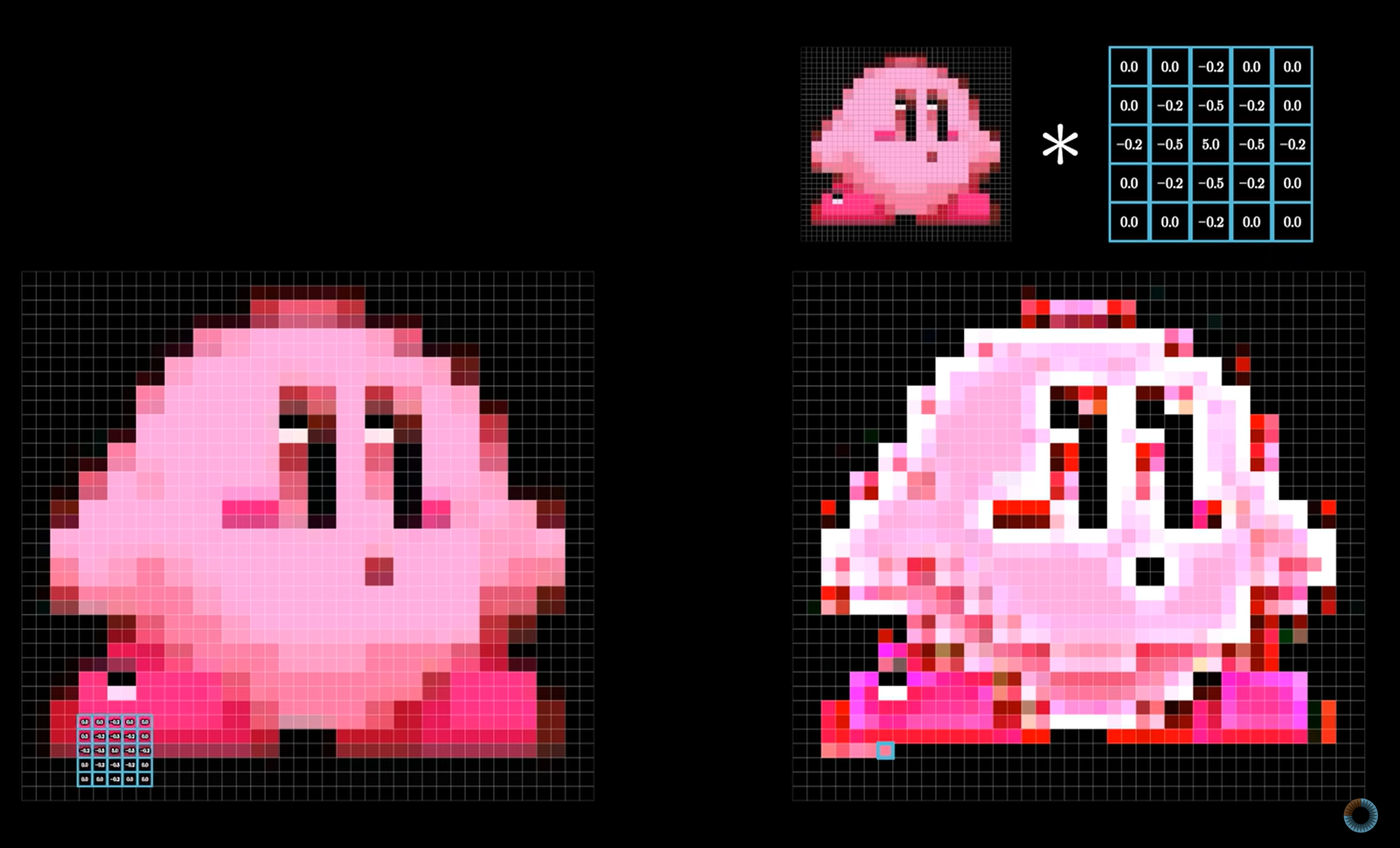
Kirby cares about Strides
Say I am trying to develop a CNN to identify Kirby.
It might make sense for me focus on features such as Kirby’s iconic pink colour, round shape and eyes rather than focus on Kirby’s mouth or head.
Hence, It would make sense for me to increase the striding to more than one in order to reduce the dimensions of the output of image and to focus better on higher-level features.

Slide 18

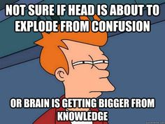
Patience…. This all will make even more sense soon
Hold on to your knowledge of how to do Convolutions! Visualise the process!

Slide 19
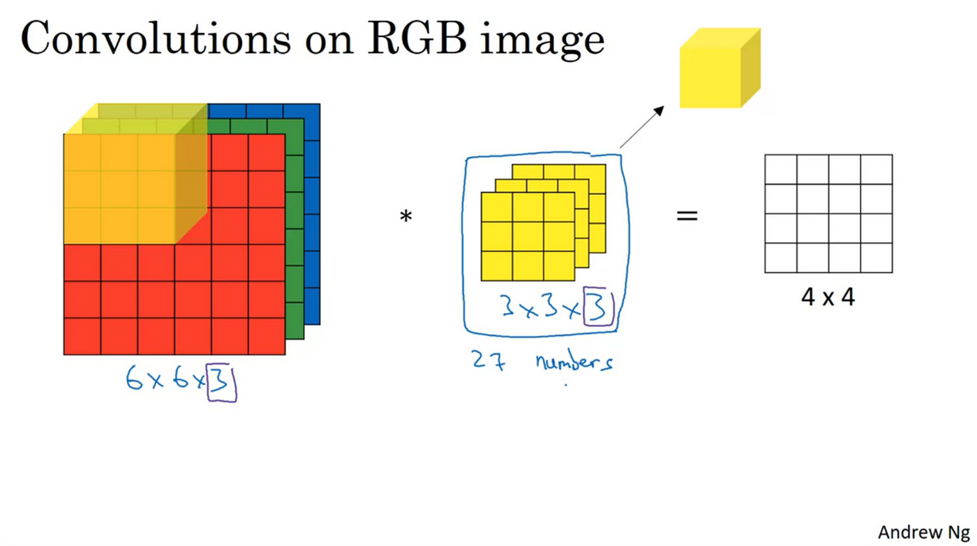
Convolutions over Volumes
We now know how convolution works for images with 2D data, but what about RGB images?
RGB images have three colour channels, their data grid can be thought of as a cube, data of each channel stacked on top of the other

Slide 20
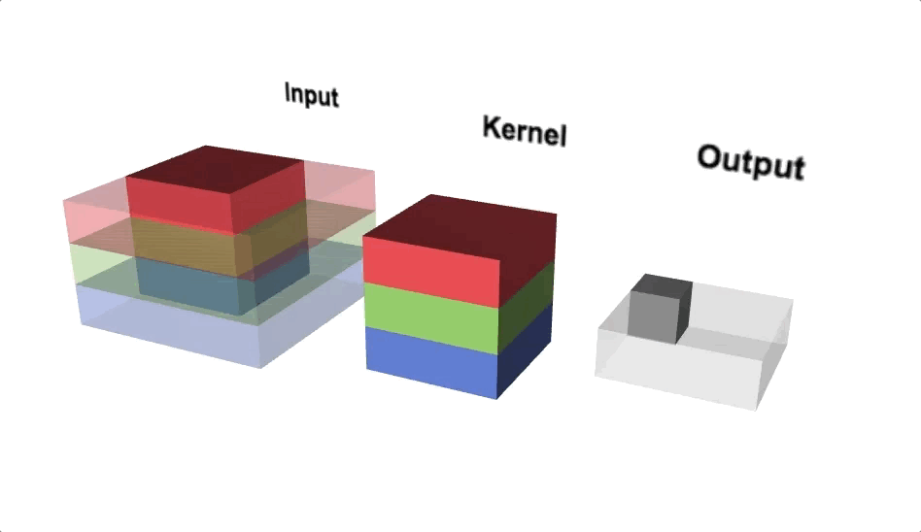
A neat visualisation of Convolutions over Volumes

Slide 21
Convolutions over Volumes - 2
An important thing to note is, the filter must also have the same number of channels/slices as the input image i.e. filters must also be 3D
Each slice of the filter, will convolve with the corresponding slice in input
The output of convolution however, will still be a single channel/slice image

Slide 22
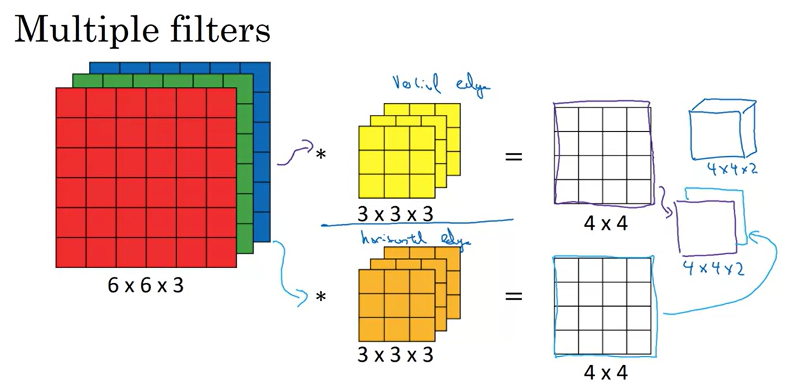
Convolutions over Volume - 3
We can use multiple 3D filters separately on the 3D input and then stack the separate outputs from the convolution operation between the input and each filter.
Here, an RGB 6x6 image and 2 3x3 3D filters are undergoing convolution and we stack the 2 separate outputs to get a 4x4x2 output.

Slide 23

All that for a single convolutional layer
Now we understand Convolutions to a decent extent. It’s simply an operation between the image and the filter, the filters help us pick out features and they are learnt by the NN, padding and striding help us tune our focus on features. Let’s look at one layer of a ConvNet.

Slide 24
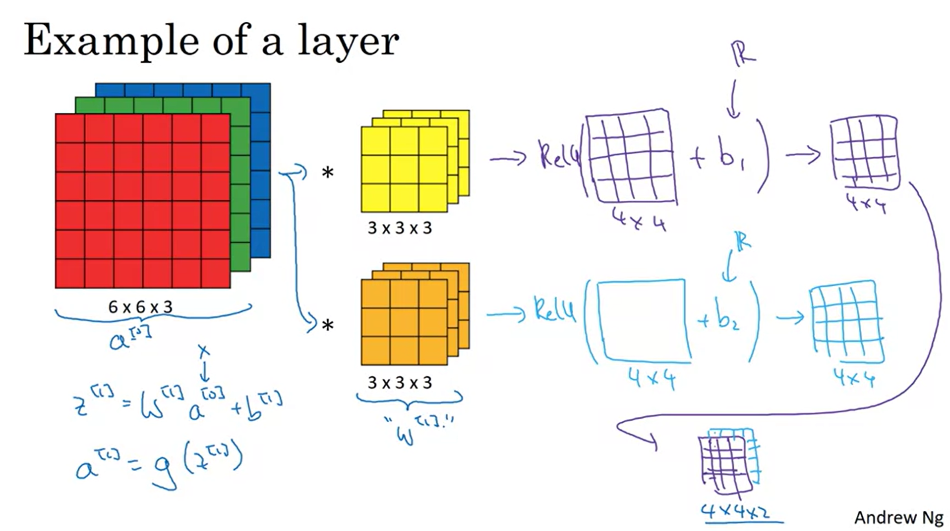
A single ConvNet Layer

